Slide 1
Biotics 5 Prototype testing Milestone 4 Thursday, November 8, 2012 2:30 – 4:00 PM EST

Slide 2
Agenda
New Release – Milestone 4
Release Notes
Test Plan
Demo
Connecting to map services via ArcGIS
Providing Feedback
Upcoming schedule
Discussion/Questions
Notes:
Biotics 4
Living with Aging system
Compatibility issues in new environments (Windows, Oracle)
Other common problems (DM comments)
Phasing out Biotics 4 – Support will continue through FY13 and be phased out in FY14 (discuss with Lori)
Four stages;
Market introduction / General Availability (2003- 2004)
Growth/Extended (2004 – 2010)
Maturity (2010 – 2013)
No new versions or patches
Standard support provided (helpdesk and email)
Continued expansion of online information and Knowledgebase
With release of Biotics 5 in 2013 we will enter the last 12 month of this stage
Limited support provided (helpdesk and email)
New environments not certified
Few updates to online information (i.e., Knowledgebase)
Saturation and decline/Retired (2014) – final phase of Biotics 4
Standard helpdesk and email support ends
Access to very limited support through Biotics 4 online help archives

Slide 3
Release Notes & Testing
Release Notes
Test Plan
Testing
Clear your cache!
Notes:
Biotics 4
Living with Aging system
Compatibility issues in new environments (Windows, Oracle)
Other common problems (DM comments)
Phasing out Biotics 4 – Support will continue through FY13 and be phased out in FY14 (discuss with Lori)
Four stages;
Market introduction / General Availability (2003- 2004)
Growth/Extended (2004 – 2010)
Maturity (2010 – 2013)
No new versions or patches
Standard support provided (helpdesk and email)
Continued expansion of online information and Knowledgebase
With release of Biotics 5 in 2013 we will enter the last 12 month of this stage
Limited support provided (helpdesk and email)
New environments not certified
Few updates to online information (i.e., Knowledgebase)
Saturation and decline/Retired (2014) – final phase of Biotics 4
Standard helpdesk and email support ends
Access to very limited support through Biotics 4 online help archives

Slide 4
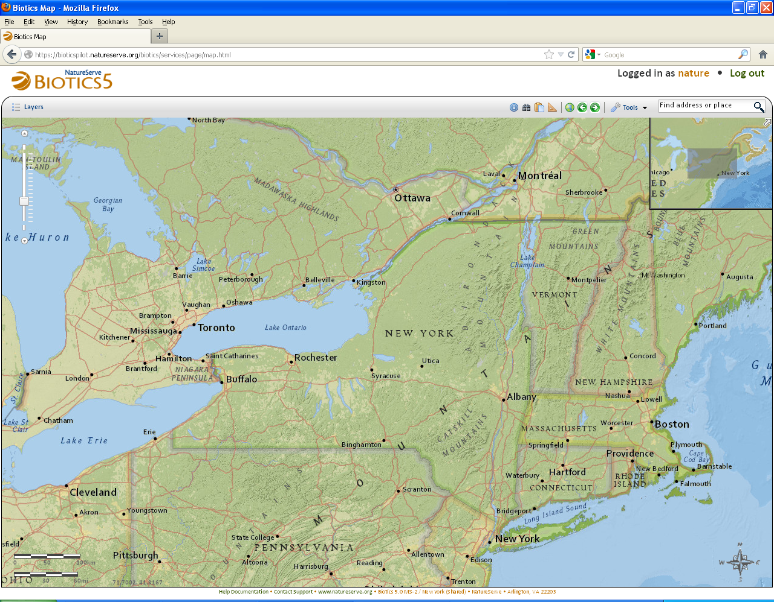
Milestone 4 Demo

Slide 5
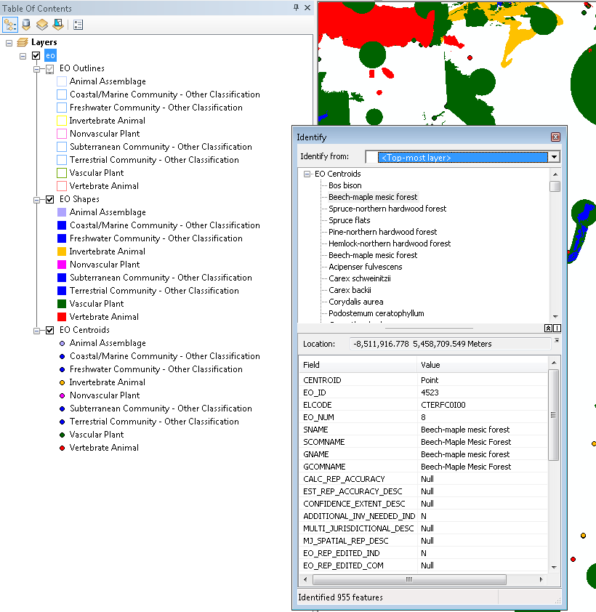
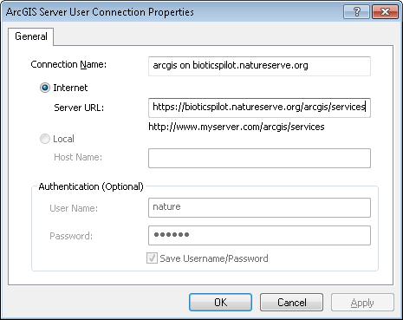
How do I connect to the Biotics map services via ArcGIS?

Slide 6
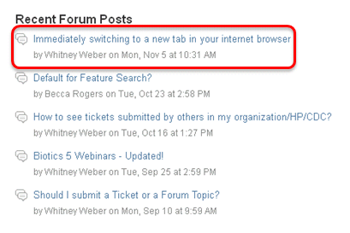
Providing Feedback

Slide 7
What you have reported
Resolved
BX-99: Add keep-alive heartbeat to map viewer and other pages
BX-203: Format attributes shown in Feature Details windows
BX-305: Undefined localized text keys in Milestone 3 release
BX-308: Properly format the scale displayed in the map viewer
BX-326: Re-label Unsuitable Habitat Feature options
BX-419: Improve exiting a working list

Slide 8
What you have reported
Issues Submitted since the last meeting - Open
BX-312: Offer option to view results (Identify & Feature Search) in a table
BX-323: Update search dialogs to reflect results without requiring the user to scroll
BX-325: Allow users to zoom to specific scales
BX-327: Provide message to indicate no records in option of Include in Proposed EO dialog
BX-336: Display Scientific Name as the Element Subnational (Global/National) page header instead of the ID number
BX-399: Buffer tool gives error when buffering point and line SFs
BX-400: Update Draw/Edit Toolbar help topic to reflect NOTE on buffer tool
BX-413: When creating a SF, the Locational Uncertainty Type options are not indented when CFT is Point or Line
BX-418: Don’t close Search window automatically after adding to working list

Slide 9
What you have reported
Issues Submitted since the last meeting - Open
BX-420: Replicate ‘Record maintenance’ and ‘Attribute maintenance’ functionality from Biotics 4
BX-425: Feature Search or Filter – hitting spacebar right after selecting an operation selects it again
BX-440: Text/background color options to reduce eye strain
BX-452: Add Clear Search Criteria button to Spatial Search section of Feature Search

Slide 10
Upcoming Schedule
Milestone 5 release:
Thursday, December 6th
2:30 – 4:00 PM Eastern
User-suggested topics:
If you have a specific topic you would like us to cover in an upcoming meetings let us know preferably no later than the week prior to that meeting

Slide 11
Discussion/Questions

