Slide 1
Biotics 5 network Pilot release Wednesday, October 24th & Thursday, october 25th 2012 2:30 – 4:00 PM EST

Slide 2
Agenda
Completed components
Release schedule
What’s new in the spatial model?
Demo
Accessing Biotics 5
Online help and support
Network participation
Q&A

Slide 3
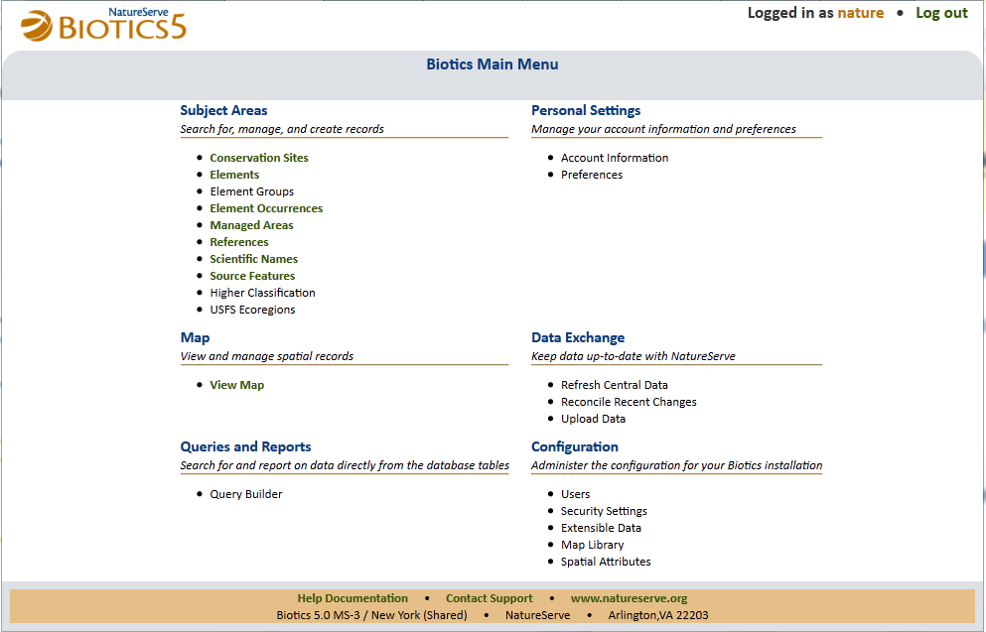
Completed Components

Slide 4
Milestone Release Plan
New and enhanced functionality in the coming months
Month | Milestone | Functionality
November | MS – 4 | Working list enhancements Feature details window enhancements
December | MS – 5 | Advanced working list functionality Search dialog enhancements EO creation process refinements
January | MS – 6 | User management and security Source feature workflow refinements Support for EO modification
February – May | MS-7, 8, 9 & 10 | Remaining record page types Spatial attribute calculations Archiving shapes Administrator functionality
June | Public release candidate | Candidate release for final user testing

Slide 5
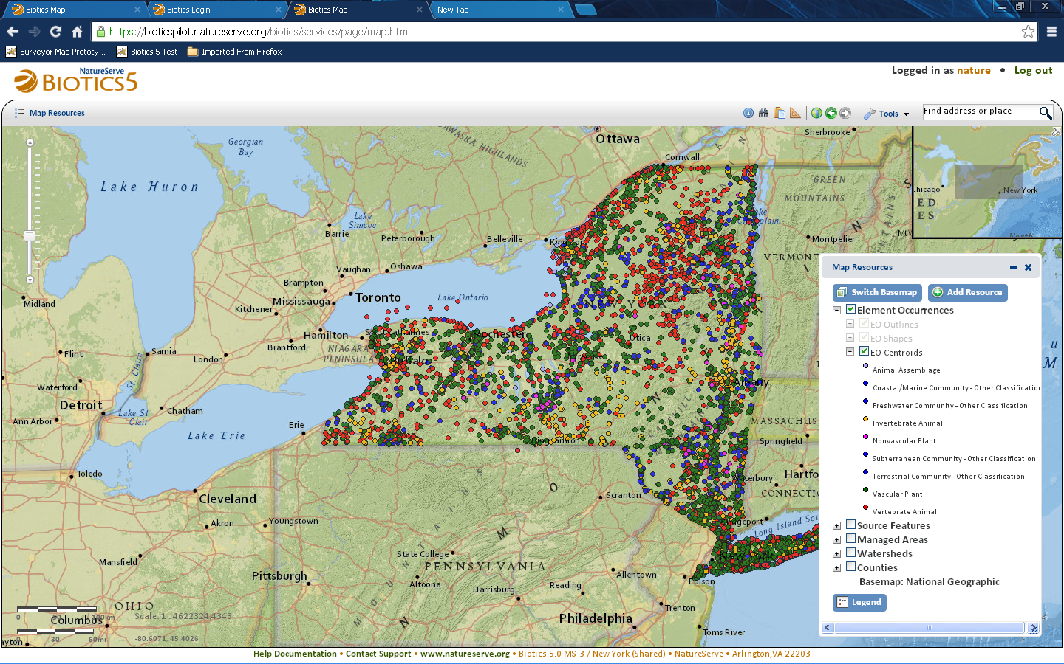
Biotics 5 – Advancing Day by Day!

Slide 6
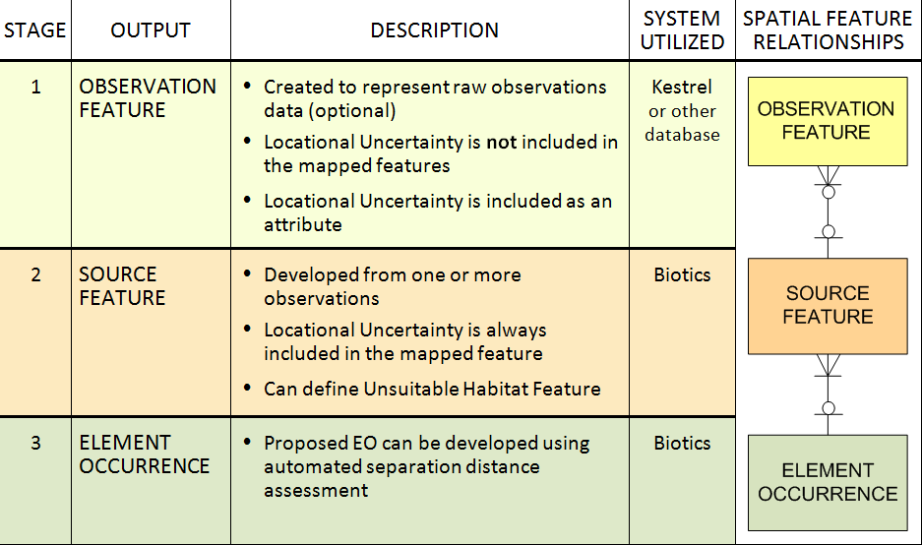
What’s New in the Spatial Model
Methodology for Developing Spatial Features

Slide 7
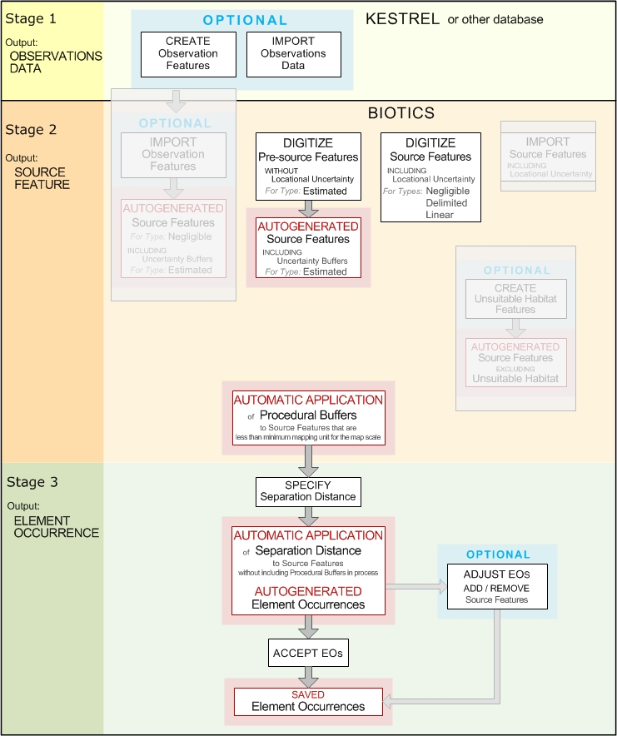
Spatial Workflow

Slide 8
Spatial Workflow

Slide 9
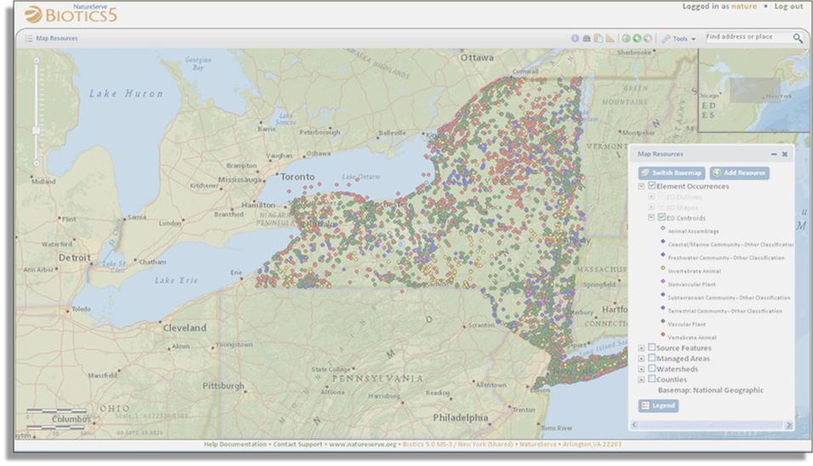
Demo

Slide 10
Accessing Biotics 5
http://bioticspilot.natureserve.org
Username: see spreadsheet associated with meeting
Change Password: oakleaf
Shared Instance: New York

Slide 11
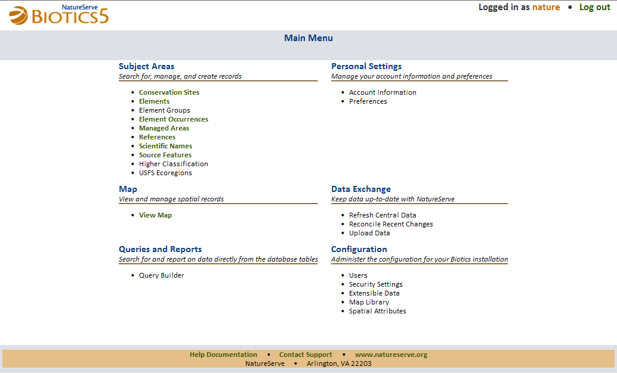
Online Help and Support

Slide 12
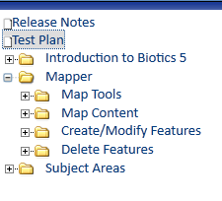
Online Help
Release Notes
Test Plan
Biotics 5 Documentation
Populating initial content is a work in progress
Contents grow with each new release as functionality is added

Slide 13
Test Plan
Link to Test Plan available from Online Help
We want your feedback on:
Application functionality
Workflows
Spatial methodology
Documentation
Help Desk

Slide 14
Type of Feedback
Submit Help Desk Tickets to report:
Bugs
Improvements
Feature Requests
Questions
Use Help Desk Forums to:
Vote on Feature Requests
Add Tips & Tricks

Slide 15
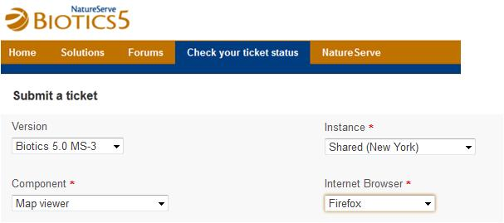
Providing Feedback
Submitting Help Desk Tickets:
Specify which tool component and version your comment is about
Indicate which web browser you’re using (IE, Chrome, Firefox)
Include the page URL – this contains pertinent Record Number data
Provide screenshots

Slide 16
What’s happening to my Ticket?
Issues considered for further development:
Awaiting Development Consideration:
Status: Pending Substatus: Development
Implemented by Development
Status: Resolved (See Release Notes)
Notes:
Over 70 bugs, improvements, and feature requests submitted by testers to date
Nearly half already corrected or implemented
The remainder are either awaiting resolution or have been cataloged as future system requirements

Slide 17
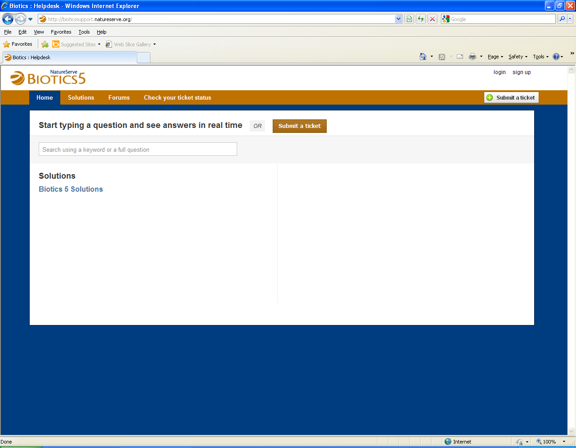
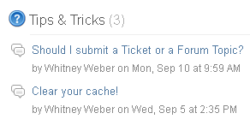
How to Contact Support Help Desk
http://bioticssupport.natureserve.org
Find a solution
Submit a ticket
Information
Participate in forums
Feature Requests
Continue to submit Biotics 4 issues to the Biotics 4 Help Desk: (http://support.natureserve.org/customer/default.aspx)

Slide 18
Support for Biotics 4
Support will continue through 2013 and be phased out in 2014
Life Cycle stages
Biotics first provided to Network (2003)
Periodic releases – system improvements and patches (2004 – 2010)
Maturity (2010 – 2013)
No new versions or patches
Standard support provided (helpdesk and email)
Relevant content added to Knowledgebase as needed
With release of Biotics 5 in 2013 we will enter the last 12 months of this stage
Limited support provided (helpdesk and email)
New environments not certified
Static Knowledgebase
Final phase of Biotics 4 (2014 – ……)
Standard helpdesk and email support ends
Biotics 4 helpdesk content remains available statically

Slide 19
Testing Schedule
During the pilot testing period a new release will be deployed each month
Release notes describe new functionality
Test plan provides example test scenarios
Your feedback on each monthly release can influence improvements in future releases

Slide 20
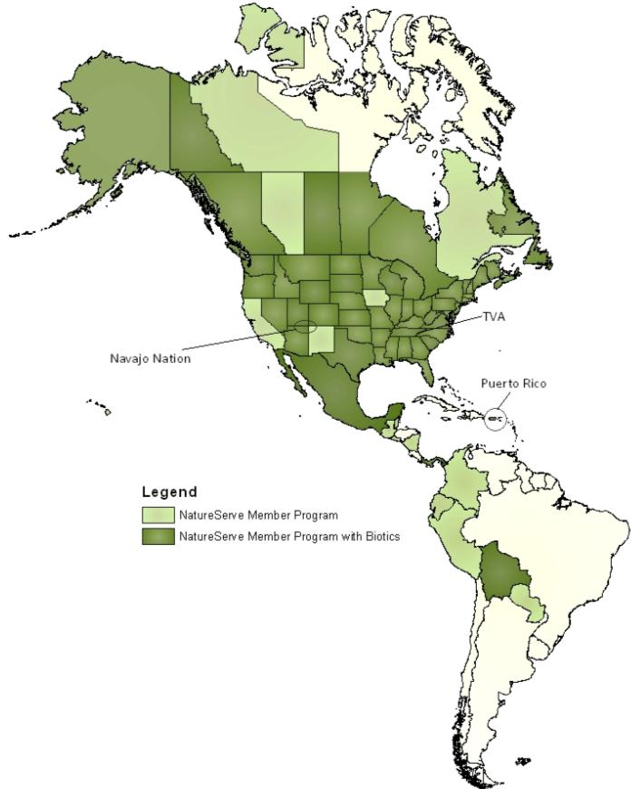
Biotics Technical Review Team
Yukon
Randi Mulder
Ontario
Pete Sorrill
NatureServe Canada
Meherzad Romer
British Columbia
Debbie Webb
New York
Shelley Cooke
Wyoming
Melanie Arnett
Gary Beauvais
Indiana
Ron Hellmich
Texas
Bob Gottfried
Guatemala
Mercedes Barrios

Slide 21
Biotics 5 Pilot Testers
Saskatchewan
Michigan
New York *
British Columbia
Virginia
Wyoming
* NatureServe network users can access the New York NHP shared pilot database

Slide 22
Q & A

